Slide 1
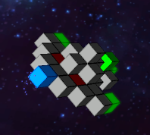
Motivation Voxels
Fully destructable World
Accurate textbook physics:
collision
destruction
Impacts
Simple model design

Slide 2
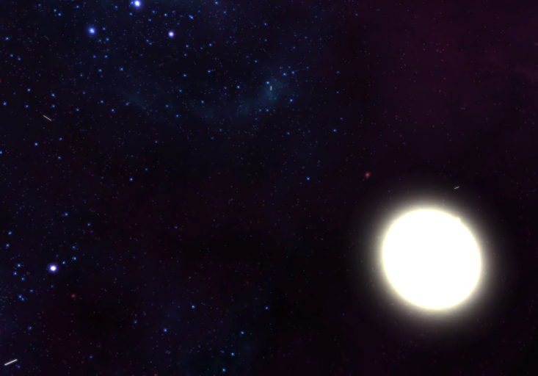
Motivation Space
Space Games are awesome
Dogfight combat
Science Fiction setting
Open world
Not limited by „realism“

